Slide 1

AI and Machine Learning for IoT Big Data

Slide 2
Outline of the Course
Introduction: Background of IoT, Big Data, AI
Collect, analyze data from IoT on a large scale
Elements and practice of statistics
AI methods for data science
Practical usage of AI for Big Data from IoT
Getting further with AI: internal workings
Moving into the real world

Slide 3
Lecture 1: Introduction
Outline of the course
From telemetry to IoT
From data to Big Data
From statistics to AI analytics
Motivations and use cases
State of art in frameworks, tools, services
Topics for study

Slide 4
From telemetry to IoT

Slide 5
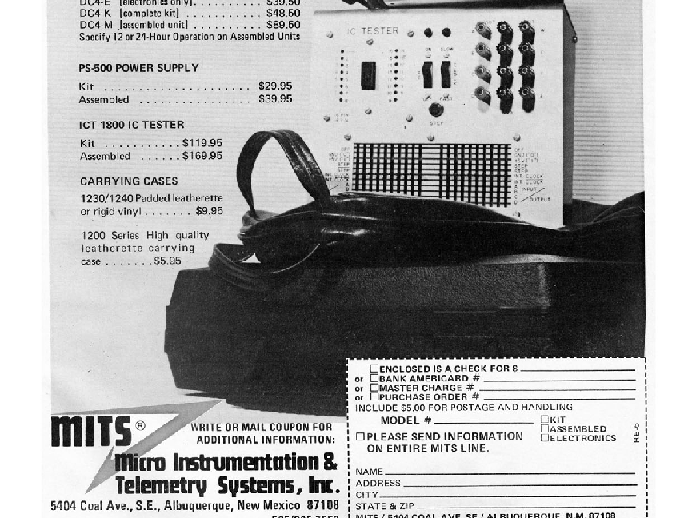
Telemetry: private communication when justified
• Public Domainview terms
• File:MITS Test Equipment 1973.jpg
• Created: 1 June 1973
Typical uses: collecting field data for power distribution, meteorology, military, plants, geology, biology, …
Communication on dedicated lines, dedicated radio spectrum, microwave
Case-by-case systems, different across domains, no unification
Notes:
Telemetry still exists for professional use
Not necessarily “Internet” of things: private communication, or not even communication (data is stored in devices then retrieved)
Discuss e.g. meteorological data, weather stations, balloons; how much is taken over by satellites
Many areas are now taken over by new IoT technologies, opening up to “amateurs” too

Slide 6
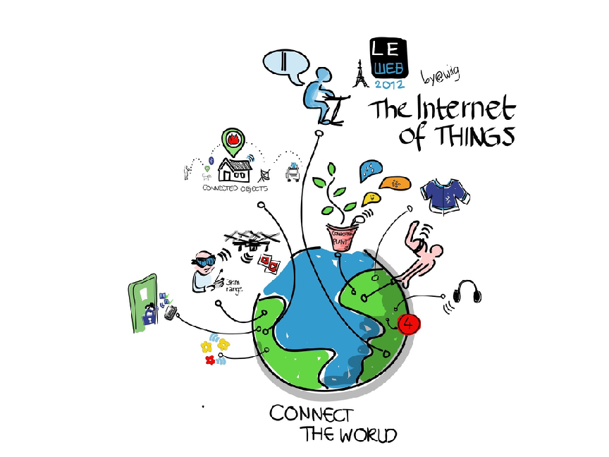
Internet of Things: connected devices everywhere
Image credits: By Wilgengebroed on Flickr [CC BY 2.0 (http://creativecommons.org/licenses/by/2.0)], via Wikimedia Commons
Fiber and mobile network connectivity brings free communication access
Low-cost sensors allow easy entry, quick expansion
Notes:
Buzzword vs. reality: why is it hyped so relentlessly?
Corporate vs. amateur IoT: what can be done with Arduino, cheap sensors?
Solicit examples

Slide 7
Characteristics of IoT
Information is generated without human intervention
Huge variety: from low-dimensional low-speed sensory data to streaming images
All fields: agriculture, technology, commerce, …
Usually spatially distributed sources
Usually inherent noise, interruptions, missing values, temporal instabilities
Notes:
Compare with human-generated data sources: Internet, SNS - how are they different from IoT?
Trends in IoT: growth, promises, threats

Slide 8
Discussion
What are the roots of the IoT revolution?
Why now? What happened recently to start it?
Where do we see it happening? Do you know IoT around you?
What are the trends? What comes next?
What does it mean to you?
Notes:
Assignment: essay about personal experience or interest

Slide 9
From data to Big Data

Slide 10
Data in the sciences and technology
Image credit: Source=Originally from [http://nl.wikipedia.org nl.wikipedia]; description page is/was [http://nl.wikipedia.org/w/index.php?title=Image%3AKalibratievoorbeeld.gif here]
Recording instrument readings: temperature vs. time, displacement vs. stress, etc.
Usually low dimensionality, with well-understood background knowledge
Notes:
Fitting a regression line to a few data points

Slide 11
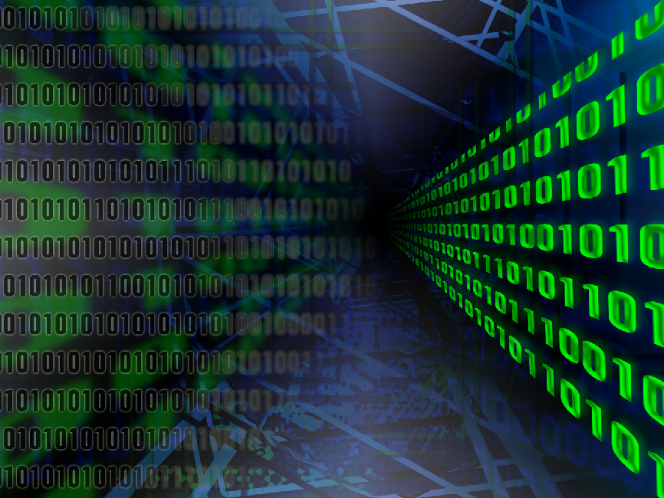
Big Data: first gigabytes, now terabytes
• Public Domain
• File:DARPA Big Data.jpg
• Created: 28 January 2013
Thousands of data sources, constantly streaming new data
Would not fit in a single computer, cannot visualize easily, no established domain knowledge available, …
Notes:
Continue discussing common perception of BD

Slide 12
Discussion
Why Big Data differs qualitatively from “small data”? Is it not just a question of quantity?
Besides IoT, where is Big Data generated?
Who gets BD (Big Data) from IoT devices? Can you find examples?
What do you expect from the BD of IoT?
Notes:
Consider examples from other areas, not just from IoT:
web browsing records
Twitter, Facebook posts
online shopping
How is Google, Amazon analyzing, extracting, monetizing BD?
Now: what carries over to IoT?

Slide 13
From statistics to AI analytics

Slide 14
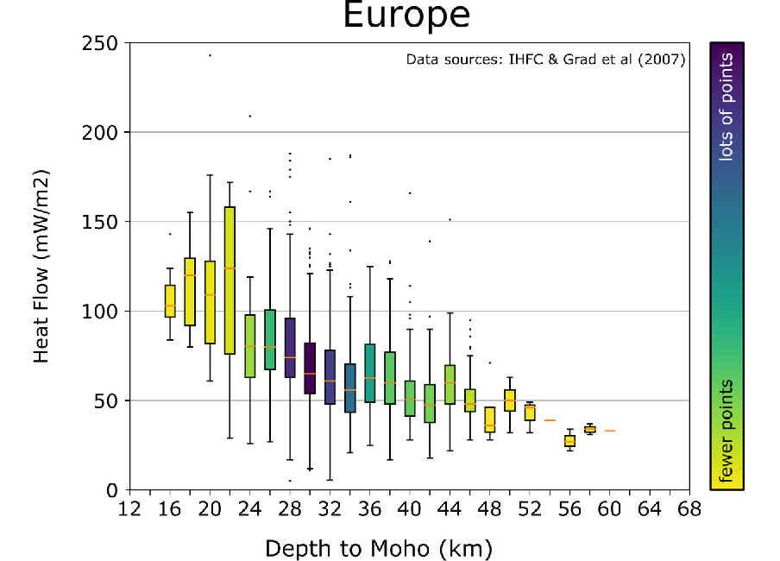
Descriptive statistics: analyze data for features, trends
Image credits: Raymi Castilla (https://commons.wikimedia.org/wiki/File:Boxplot_Europe_heat_flow_vs_Moho_depth.png), https://creativecommons.org/licenses/by-sa/4.0/legalcode
Data is collected, cleaned, visualized, inspected.
Based on fitting observations to probabilistic models.
Notes:
Motivate thinking about statistical analysis:
how to put lots of data into a few numbers?
how to find less obvious trends?
how to say if a difference is significant or not?

Slide 15
Clustering in statistics
• Public Domainview terms
• File:Cda sur iris.jpg
• Created: 14 December 2006
The “IRIS” dataset: two factors allow separation of observations into 3 classes.
This kind of analysis was usually done interactively and iteratively.
Notes:
Data from different sources or processes mixed together, we want to separate them

Slide 16
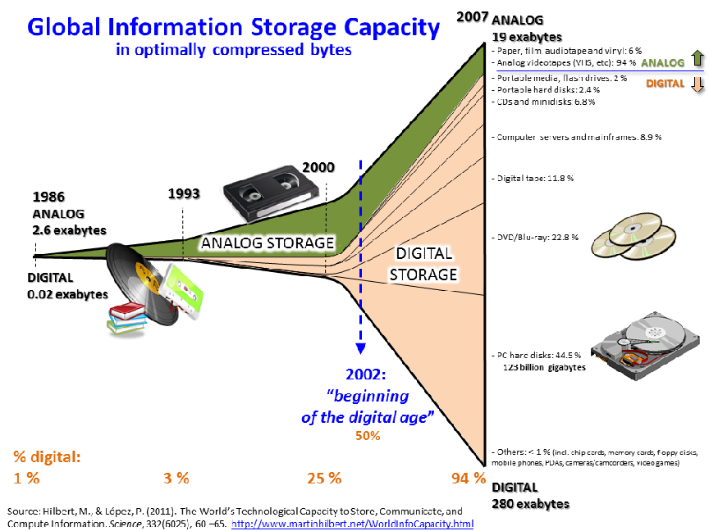
Data explosion! How to deal with it?
Image credits: Myworkforwiki (https://commons.wikimedia.org/wiki/File:Hilbert_InfoGrowth.png), „Hilbert InfoGrowth“, https://creativecommons.org/licenses/by-sa/3.0/legalcode
Notes:
Would be overwhelmed by mountains of data if we had no tools

Slide 17
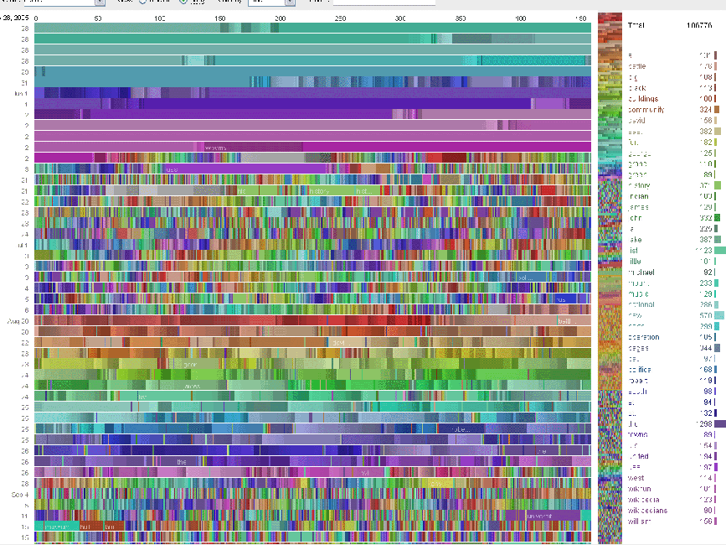
Example of “big data”: how to fit into statistics?
Image credits: Fernanda B. Viégas (https://commons.wikimedia.org/wiki/File:Viegas-UserActivityonWikipedia.gif), „Viegas-UserActivityonWikipedia“, https://creativecommons.org/licenses/by/2.0/legalcode
Notes:
Visualization is not always enough to spot important patterns

Slide 18
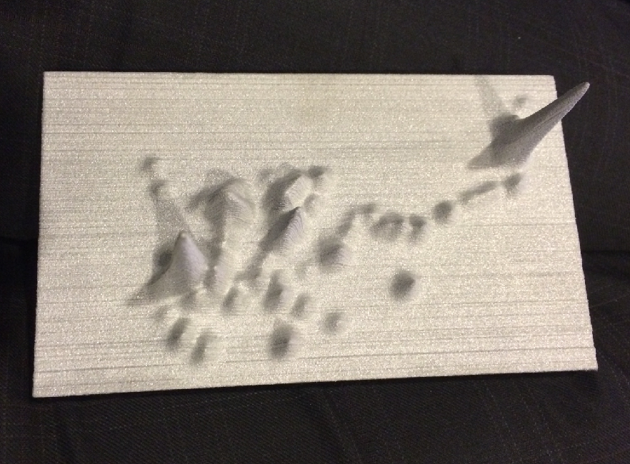
One approach: 3D topographic model
Image credits: Bjoertvedt (https://commons.wikimedia.org/wiki/File:Harvard-Telenor_topographic_3D_model_mobile_calling_patterns_pakistan_IMG_7743_dengue_fever_2013.JPG), https://creativecommons.org/licenses/by-sa/4.0/legalcode
3D topographic modellation of the mobile calling patterns in a Pakistani district during the dengue fever outbreak in 2013. Part of a Harvard University - Telenor big data research project. Mobile phone records may predict epidemics of mosquito-borne dengue virus
Notes:
Still, data scientists always try to put their data into an intuitively understandable form

Slide 19
Biggest challenge: human analysis can’t keep up
Image credits: François-Dominique (https://commons.wikimedia.org/wiki/File:Mldemos3.png), https://creativecommons.org/licenses/by-sa/4.0/legalcode
Classifiers, predictors, cluster detectors, anomaly detectors
created (hopefully!…) automatically, without human guidance
Notes:
AI to the help: Machine Learning, Deep Learning finds patterns and actionable information

Slide 20
Discussion
What do we want from AI (Artificial Intelligence) for BD (Big Data) analytics?
Why classical statistics has limitations in dealing with BD?
What other applications of AI are around us?
What are the social, economical, and ethical implications of AI?

Slide 21
Motivations and use cases

Slide 22
IoT + BD in Healthcare
Asthmapolis (…) is on a mission to hack your inhaler. The startup has designed snap-on, Bluetooth-enabled sensors that track how often people are using their inhalers (along with location and time-of-day), along with analytics and mobile apps for iOS and Android to help them visualize and understand their triggers and trends while receiving personalized feedback.
… early studies found that this access to realtime data was able to reduce the number of people with uncontrolled asthma (or those not regularly using inhalers) by 50 percent.
https://techcrunch.com/2013/04/05/asthmapolis-wants-to-hack-the-inhaler-and-help-26-million-americans-better-track-and-manage-their-asthma/
Notes:
Many medical instruments are capable of generating data
Aggregating such data streams can enable deep analysis

Slide 23
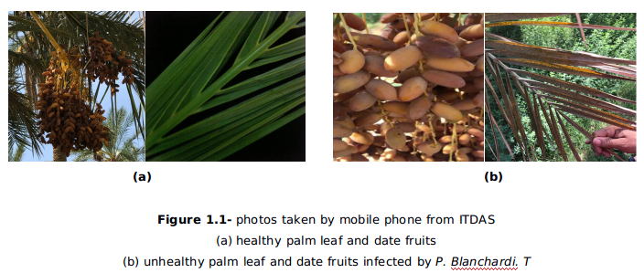
Plant disease detection and prediction
IoT + BD in Agriculture
Date palms in Algeria are threatened by the “white scale” pest.
Image classification with AI detects infections, IoT sensor data helps analyze environmental conditions promoting infections.
Tech4Dev 2018 Lausanne
IoT and AI Methods for Plant Disease Detection in Developing Countries
Sandor Markon¹, Hadjer Hamaidi¹, Tun Tun Win¹, Ronald Criollo², Ryo Ohtera¹, Marco Zennaro^{1,3}
Notes:
Information directly from farms can be used for intelligent agriculture

Slide 24
IoT + BD in Electricity Distribution
Advanced metering infrastructure (AMI):
essential for Smart Grids
not only billing but system monitoring, outage detection
real time analytics with Stream Computing
Big Data Analytics for Distribution System Monitoring in Smart Grid
Shibily Joseph* and Jasmin E A
Government Engineering College, Thrissur, Kerala, India
http://www.sersc.org/journals/IJSH/vol11_no5_2017/2.pdf
Notes:
Discuss the situation of the power metering of the students’ home
What other utilities could have similar intelligent infrastructure?
Water?
Gas?
Sewage?
Compare with ISP (Internet Service Provider) infrastructure

Slide 25
State of art tools

Slide 26

Many Open Source and commercial offerings
Handle huge amounts of data
Create distributed process flows
We will do it with PySpark
Spatio-temporal analysis with Thunder
Deep Learning with TensorFlow
IBM, Google, Amazon, …
Notes:
Tell about competing offerings like Google Cloud

Slide 27
Topics for further study

Slide 28
Self-study assignment
Find examples of IoT applications
Select one that is close to you personally
What data is going to be generated?
What would be great to discover from it?
What is the approach if it were “small data”?
Can you find tools, frameworks?
Notes:
Essays submitted by students should be evaluated for understanding, originality, relevance
Warn about ethical issues: plagiarism, fabricated data etc.

